Slide 1
Amazon Web Service Reference Architectures
By ALTOTECH

Slide 2
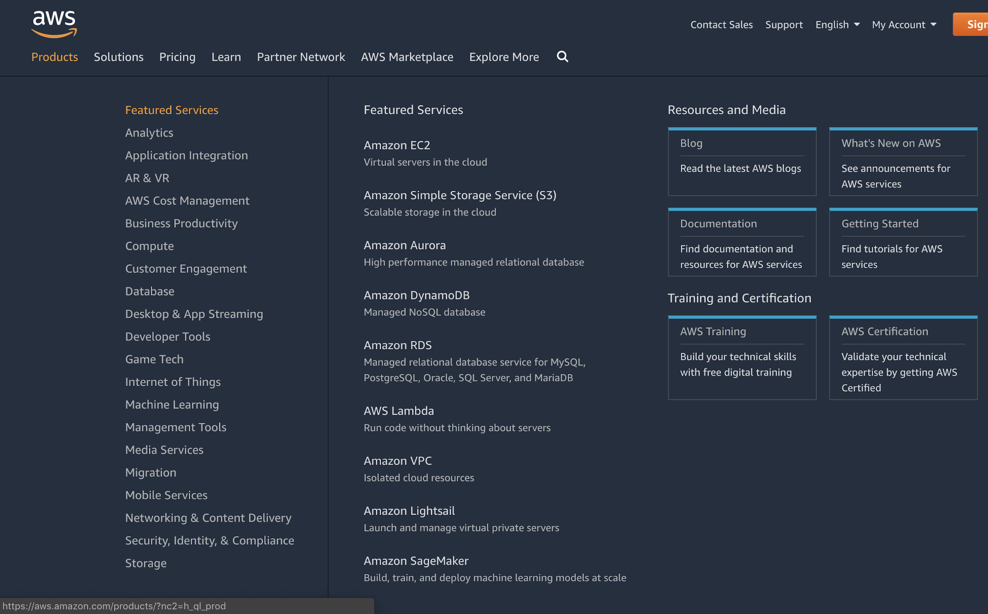
Amazon Web Service
Cloud service

Slide 3
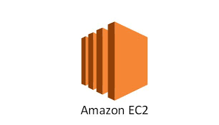
Amazon Elastic Compute Cloud (EC2)
Instances
secure, resizable compute capacity in the cloud
It is designed to make web-scale cloud computing easier for developers.

Slide 4
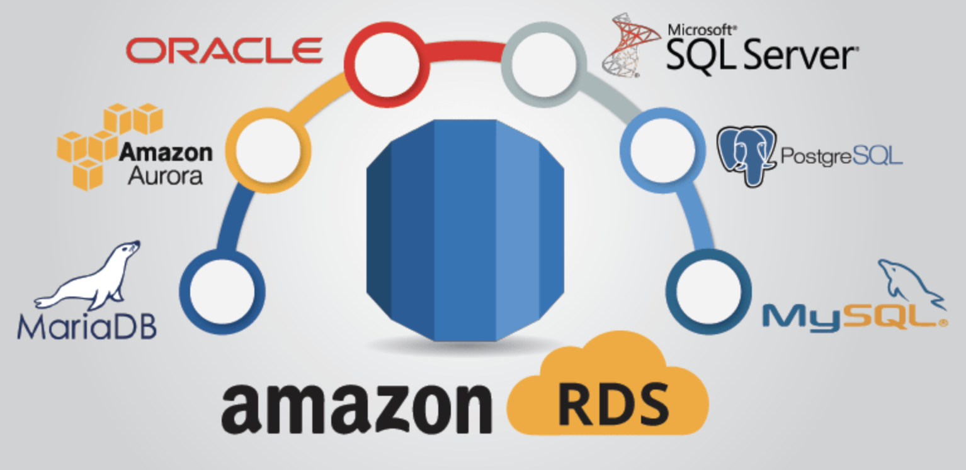
Amazon Relational Database Service (RDS)
provides cost-efficient and resizable capacity
automates administration tasks such as hardware provisioning, database setup, patching and backups

Slide 5

Amazon Simple Storage Service (S3)
object storage built to store and retrieve any amount of data

Slide 6
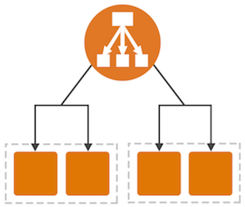
Elastic Load Balancing
handle the varying load of your application traffic in a single Availability Zone or across multiple Availability Zones
high availability, automatic scaling, and robust security

Slide 7
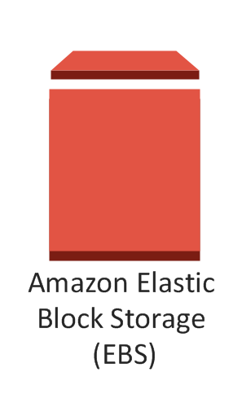
Amazon Elastic Block Store
provides persistent block storage volumes for use with Amazon EC2 instances in the AWS Cloud
EBS volume is automatically replicated within its Availability Zone to protect you from component failure
Like HDD, SSD

Slide 8
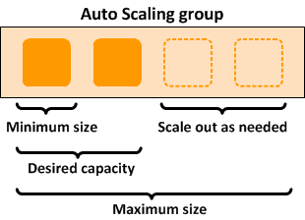
AWS Auto Scaling
automatically adjusts capacity to maintain steady, predictable performance at the lowest possible cost

Slide 9
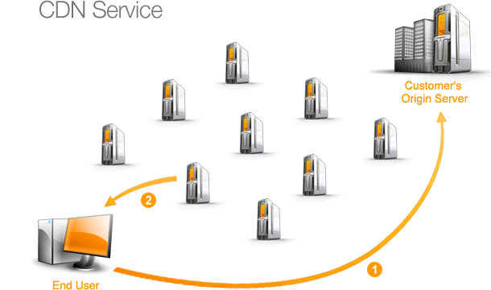

Amazon CloudFront
fast content delivery network (CDN) service that securely delivers data, videos, applications, and APIs to customers globally with low latency, high transfer speeds

Slide 10
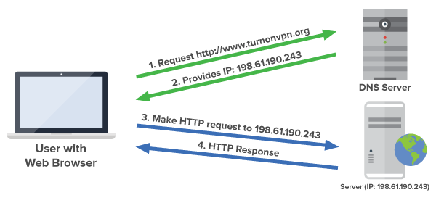

Amazon Route 53
highly available and scalable cloud Domain Name System (DNS) web service

Slide 11
WEB APPLICATION HOSTING

Slide 12
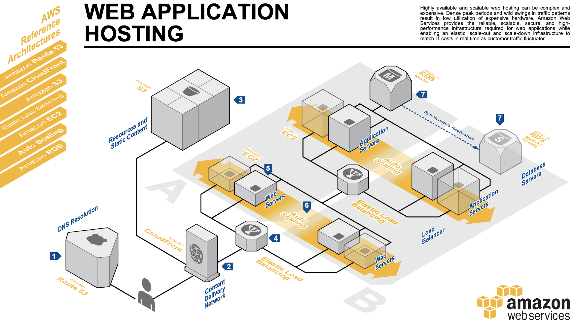

Slide 13
The user’s DNS requests are served by Amazon Route 53

Slide 14
Content is delivered by Amazon CloudFront

Slide 15
Resources and static content are stored on S3

Slide 16
HTTP requests are first handled by Elastic Load Balancing

Slide 17
Web servers and application servers are deployed on EC2

Slide 18
Auto Scaling automatically adjust your capacity up or down

Slide 19
RDS that contains application’s data is hosted redundantly on a multi availability zones

Slide 20
CONTENT AND MEDIA SERVING

Slide 21
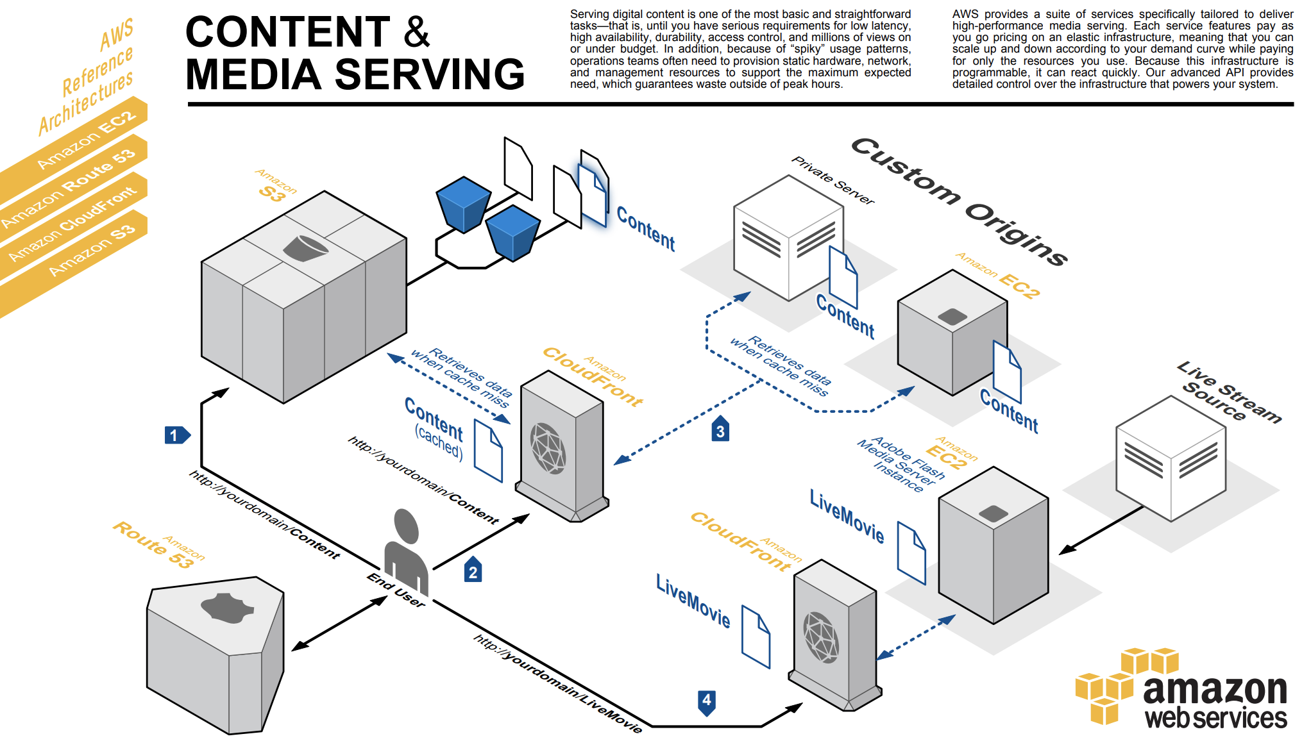
Content

Slide 22
Cached

Slide 23
Cache miss

Slide 24
Live Stream

Slide 25
FAULT TOLERANCE
&
HIGH AVAILABILITY

Slide 26
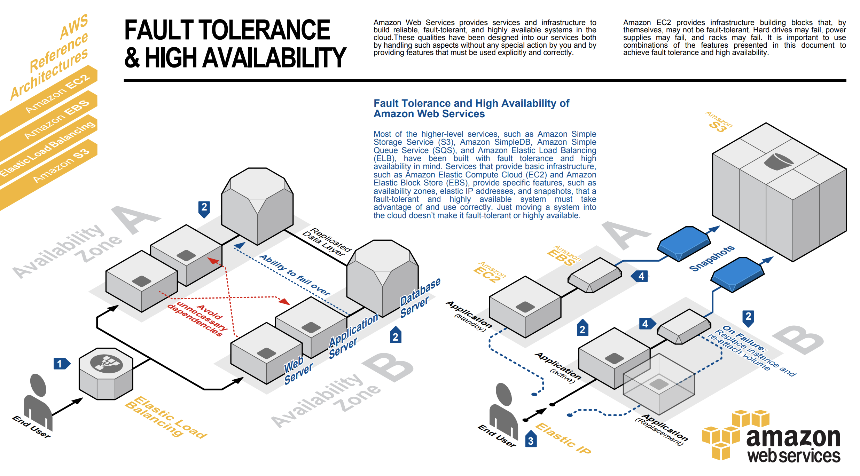
Place EC2 in multiple AZs
Avoid dependencies

Slide 27
Place EC2 in multiple AZs
Avoid dependencies

